Slide 1

Unit test using NUnit
The TDD way - Lets prove our code not guilty!!

Slide 2
Course Outline
Introduction
Fundamentals of Unit Testing
Advanced Unit Testing Techniques
Handling Dependencies
Prove not guilty with TDD
Data Driven Testing Techniques

Slide 3
Introduction
We will cover these skills
What/Why Automated Testing is used
Types of Automated Test
Lets see what a Unit test is..
What/Why TDD
Other Paradigms

Slide 4
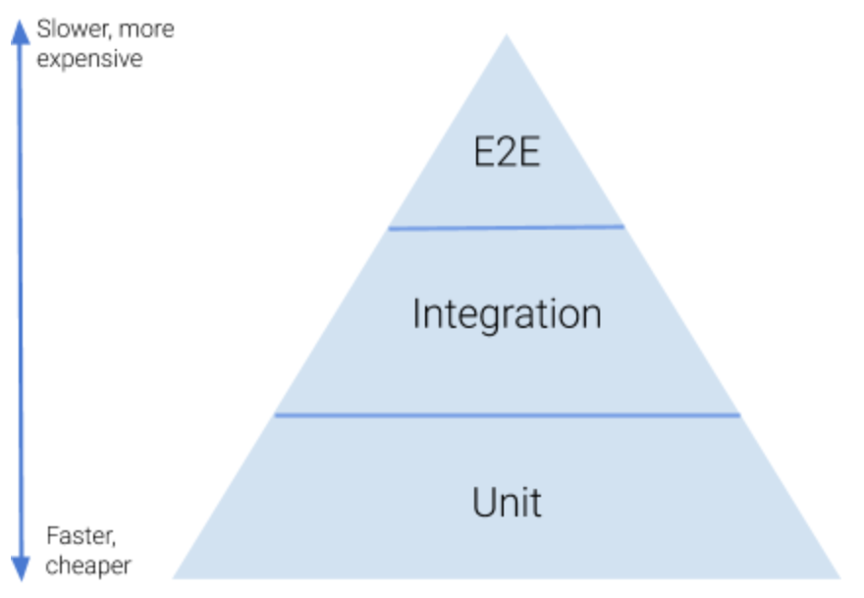
Automated Tests
Automated Test: Code that will be written to test the actual production code.
Types of Automated Tests
Unit Test
Integration Test
End to End Test
Responsibilities of each Automate Tests
Pyramid of Testing
Automated Tests
TDD
Other Paradigms
Conclusion

Slide 5
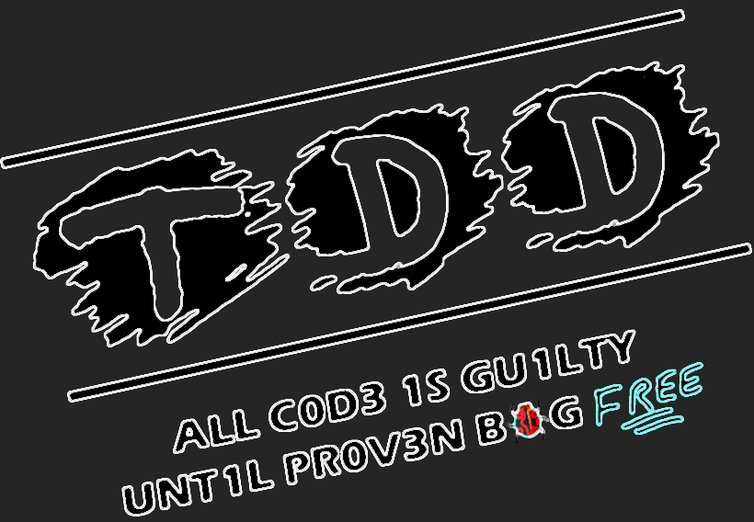
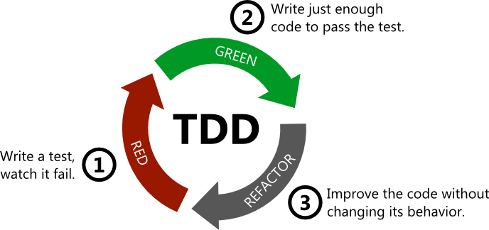
Test Driven Development
The test is developed which specifies and validates what the code will do. In simple terms, test cases are created before code is written. The purpose of TDD is to make the code clearer, simple and bug-free.
Circle of TDD
Write Failed Tests
Code to pass test
Refactor the code
With TDD
Ensures that your system actually meets requirements defined for it
More focus is on production code that verifies whether testing will work properly
Achieve 100% coverage.
TDD
Automated Tests
Other Paradigms
Conclusion

Slide 6
Other Paradigms
Behavioral Driven Development
Test fulfills the requirement of the specification or satisfies the behavior of the system
Also was known as Acceptance TDD
The benefit is that it offers more precise and organized conversation between developers and domain experts
Agile Model Driven Development - Reference
Envisioning
Iteration Modeling
Model storming
TDD
Other Paradigms
Automated Tests
TDD
Conclusion

Slide 7
Summary
Here is what we learned
Automated Testing:
Types of Automated Test:
Quick Unit test sample
Test Driven Development
Other Paradigms
Conclusion
Automated Tests
TDD
Other Paradigms

Slide 8
Fundamentals of Unit testing
We will cover
Lets Name the Tests
Characteristics of Test
Setup and Tear Down
Parameterized Tests
Ignore Tests
How to make trustable Tests

Slide 9
Preparing Unit Tests
Naming Convention
Name your Test projects with actual projects your are testing, ends with the type of automate tests planned to write. [ProjectName].[TestType]
For writing unit test against a project called Reservation.Core, the unit test project name is suggested to be Reservation.Core.UnitTest (for Integration test Reservation.Core.InterationTest)
Name your Test class with the actual class you are testing, ends with the word “Tests”
For writing unit test again a class called Reservation, the unit test class name is suggested to be ReservationTests
Name your Test Methods as [ActualMethodName]_[TestScenario]_[ExpectedResult]
For writing a unit test again a method CanBeCanCelled which takes a CancelledBy user, the unit test names should be CanBeCancelled_AdminUser_ExpectedTrue or CanBeCancelled_ReservedByUser_ExpectedTrue or CanBeCancelled_OtherUser_ExpectedFalse

Slide 10
Preparing Unit Tests
Characteristics of Good Tests
Create Clean, Readable and Maintainable tests (try Setup, TearDown, TestCase)
Tests should be small and simple
Tests should be isolcated
There should not be any logic inside test (Ex: if, switch, loops)
Tests should neither be more generic nor be more specific
What to Test
Out comes of the methods should be tested [Black Box]
Ideally method are of 2 types
Commands - There will be a change in the state of the Object
Queries – There will be data returned
Not to Test
Language features
3rd Party Framework features

Slide 11
Summary
Here is what we learned
Naming Convention of Tests
Characteristics of Test
Setup and Tear Down of Tests
Parameterized Tests
Ignore Tests
How to make trustable Tests

Slide 12
Data Driven Testing Techniques
We will cover these skills
Passing Method Level Data
Defined set and Ranged values
Sharing Test data
Feeding Test data from External Source

Slide 13
Passing Method level Test Data
Characteristics of Good Tests
Create Clean, Readable and Maintainable tests (try Setup, TearDown, TestCase)
Tests should be small and simple
Tests should be isolcated
There should not be any logic inside test (Ex: if, switch, loops)
Tests should neither be more generic nor be more specific
What to Test
Out comes of the methods should be tested [Black Box]
Ideally method are of 2 types
Commands - There will be a change in the state of the Object
Queries – There will be data returned
Not to Test
Language features
3rd Party Framework features

Slide 14
Summary
Here is what we learned
Passing Method Level Data
Defined set and Ranged values
Sharing Test data
Feeding Test data from External Source

Slide 15
Advanced Unit Testing Techniques
We will cover these skills
Testing Strings
Testing Arrays and Collections
Testing Exceptions and Events
Exercise - Testing return types

Slide 16
Testing Strings
Characteristics of Good Tests
Create Clean, Readable and Maintainable tests (try Setup, TearDown, TestCase)
Tests should be small and simple
Tests should be isolcated
There should not be any logic inside test (Ex: if, switch, loops)
Tests should neither be more generic nor be more specific
What to Test
Out comes of the methods should be tested [Black Box)
Ideally method are of 2 types
Commands - There will be a change in the state of the Object
Queries – There will be data returned
Not to Test
Language features
3rd Party Framework features

Slide 17
Summary
Here is what we learned
Testing
Strings
Arrays and Collections
Exceptions
Code Coverage

Slide 18
Lets handle dependencies
We will cover these skills
Tightly Coupled and loosely coupled
Dependency Injection techniques
Mocking dependencies
What Mocks are not for..
Exercise

Slide 19
Summary
Here is what we learned
Tightly Coupled and loosely coupled code
Dependency Injection techniques
Mocking dependencies
What Mocks are not for..
Exercise

Slide 20
TDD Patterns and Practices
We will cover these skills
What’s all about TDD
Lets write our failed tests
Write code to pass test
Refactor
Exercise
Stages of Unit test in TDD
Go for few more requirements

Slide 21
Summary
Here is what we learned
What’s all about TDD
Stages of Unit test in TDD
Lets write our failed tests
Production code
Make tests green

